Slide 1


Grades 2-3
English Language Arts at Yinghua Academy

Slide 2
Agenda
1. Mr. Alabi’s Background
2. Reading Street Curriculum
3. English Class Goals/Classwork
4. Homework
5. Assessments
6. Questions

Slide 3
About Mr. Alabi
Born in Minneapolis, MN
Attended the Minneapolis Public Schools.
Graduated from Morehouse College in Atlanta, GA.
Received my License from Augsburg College.
Taught English in Jeju, South Korea.

Slide 4


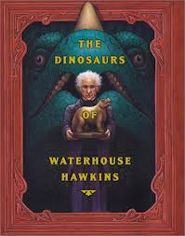
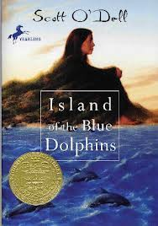

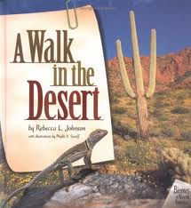

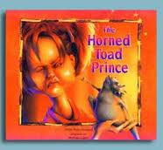
Grades 2-5 uses the Reading Street curriculum.
By Scott Foresman (Pearson)

Slide 5




Slide 6
Second Graders
Textbooks that will be used this year

Slide 7
Third Graders
Textbook that will be used this year

Slide 8
Reading Street Curriculum:
  Integrates all MN and National Common Core standards
  Helps us to prioritize instruction to support higher levels of reading and writing
  Provides rigor through differentiation of all lessons and texts
  Balances fiction and informational texts
  Builds content-area knowledge and vocabulary
  Coordinates reading, writing, & spelling
  Integrates media and 21st century skills

Slide 9
Goals for
English Class
Learn How to Read!
  Phonics, Guided Reading
Develop Writing Skills
  Writing Lessons, Journal Activities, Group Writing
Use Correct Spelling and Punctuation:
  Weekly Spelling Words, Word Sorts, Word Families, Root Words, etc.
Build Comprehension Skills
  Teacher Read Aloud, Discussions, Partner Read
Practice Handwriting Skills
  Grade 2 – Manuscript, Grade 3 – Manuscript/Cursive
Enrich Vocabulary Word Usage
  Weekly Vocabulary Words

Slide 10














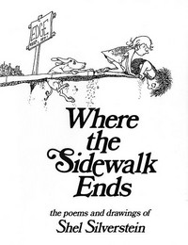

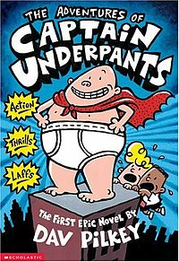



Children’s Favorite Books.

Slide 11
Classwork
Classwork Packets
  Used to Reinforce Taught Concepts
  Helps to Check Understanding
  Done in Class
  Extra Worksheets in Packet - Additional Practice at Home (NOT Required to Complete)
Activities/Projects to Enrich Curriculum
  Try to Make Learning Interesting and Fun

Slide 12
Homework & Assignments
Each week we will have a similar set of assignments.
25 minutes-plus of nightly reading, write the name of the book and the author.
Summary (2-3 Sentences) of something your child read during each week.
Spelling words
Literature skills practice (comprehension worksheets, vocabulary exercises, writing, etc.)
Student’s are required to do one page on the assigned day.
The classwork will be aligned with the homework each day.
If your child is absent all the homework is post on my classroom page.
Mr. Alabi’s 2nd/3rd Grade English Language Arts Classroom Page

Slide 13
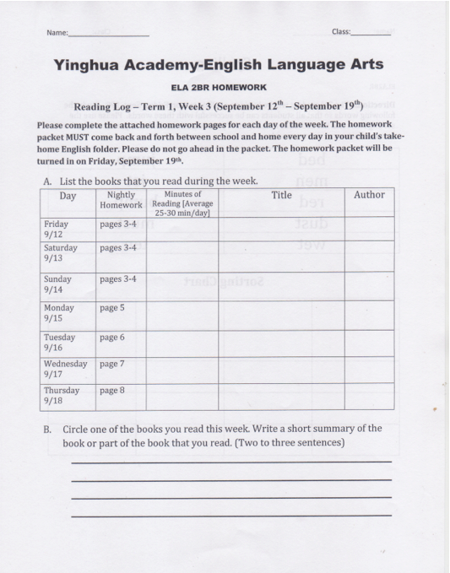
Homework Packet – Page 1
Every Friday’s students must turn in a completed homework packet.
Record the minutes that the student read or is read to daily.
Write the Book Title and and the Author daily.
Write a short summary of the book. (Two to three sentences)

Slide 14
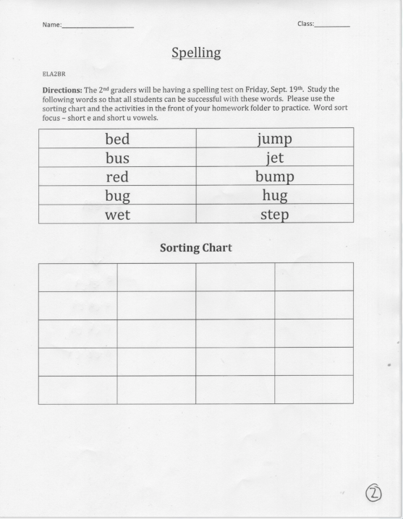
Homework Packet – Page 2
The students will take a spelling test every Friday.

Slide 15
Assessments
Formal and informal assessment will be done throughout the term and will help guide our instruction.
Data from NWEA and MCA testing drives our instruction.
Spelling tests every Friday for 2nd and 3rd grade.

Slide 16
Questions?
Contact me: ade.alabi@yinghuaacademy.org
Send me a note in the take-home folder.
Classroom Page Password - 2014newyinghua

